Slide 1

Mastering Salesforce Administration
Welcome to our expert guide to Salesforce Administration. In this presentation, we will cover everything you need to know to become a pro Salesforce admin.
MS
by MADHU SUDHAN KAMISETTY

Slide 2
Overview of Salesforce
What is Salesforce?
Why Use Salesforce?
Key Features of Salesforce
Salesforce is a cloud-based Customer Relationship Management (CRM) platform designed to help businesses manage customer accounts, sales leads, and marketing campaigns all in one place.
Salesforce offers businesses a flexible and scalable platform to manage their customer data, sales processes, and workflows, driving smarter business decisions and faster growth.
Salesforce offers a range of features such as sales and marketing automation, customer service management, analytics, and mobile apps, making it a versatile and comprehensive tool for businesses of all sizes.
The Salesforce Ecosystem
Salesforce has a vast ecosystem of third-party apps and integrations that can be used to extend its functionality and customize the platform to meet your specific business needs.

Slide 3
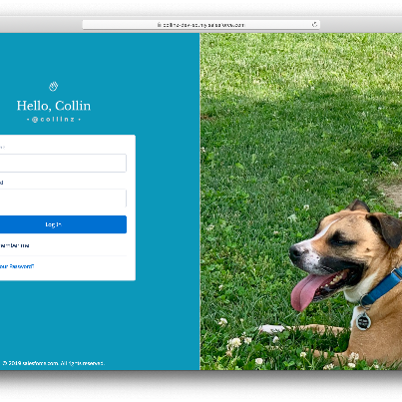
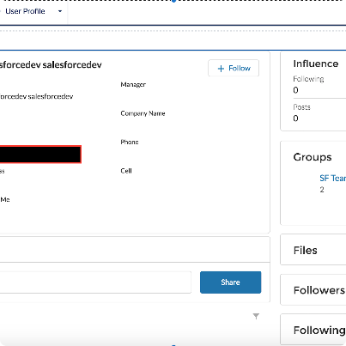
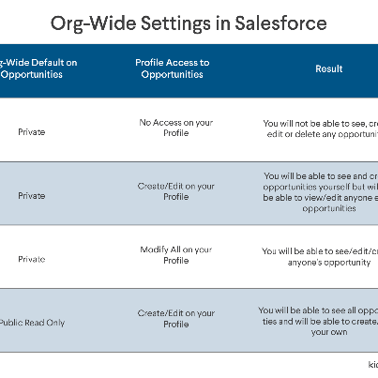
Setting up User Accounts
Login for the First Time
Create and Manage User Profiles
Define Roles and Hierarchies
When you first log into Salesforce, set up your personal settings and preferences, including your language, time zone, and email notifications.
Create and manage user profiles to control access to different areas of Salesforce. Configure profiles for roles like sales reps, marketing managers, and customer service agents and grant them the appropriate permissions.
Create roles and hierarchies to define how a user can access data and records in Salesforce. You can also define access levels and reporting relationships for different user roles.

Slide 4
Managing Data and Files
1
2
3
Data Import and Export
Managing Data Quality
File Management
You can import and export data in Salesforce to share data between systems and ensure data consistency. Export data to Excel files, or import data using CSV files.
Clean up your data by removing duplicates, merging records, and automating data validation rules. You can also use data cleansing tools to ensure data accuracy.
Store and manage files in Salesforce by using the Content tab. Use folders to organize your files, or share files with other users using Chatter.

Slide 5
Customizing Salesforce
Custom Fields and Objects
Automation
Visualforce and Lightning
Use automation tools like workflows and process builders to automate your business processes. Automate tasks like sending emails, updating records, and creating tasks.
Create custom interfaces and lightning apps to give your users the best experience. Customize your interfaces with Visualforce pages or create custom components with the Salesforce Lightning Design System library.
Create custom fields to capture data that is unique to your business. Customize page layouts to organize your data, or create custom objects to capture more complex information.

Slide 6
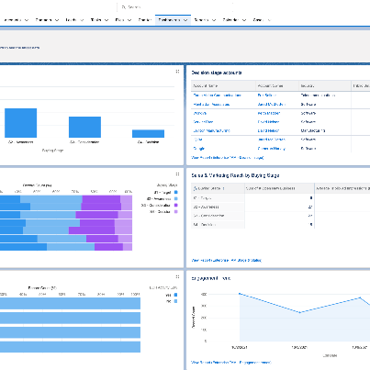

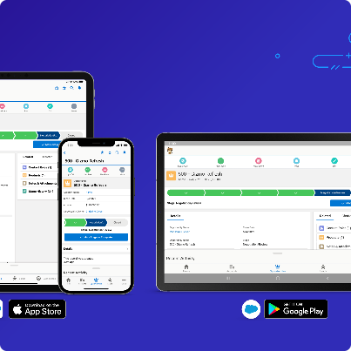
Reporting and Analytics
Reporting and Dashboards
Analytics and Data Visualization
Mobile Analytics
Build custom reports and dashboards to help you track your business metrics and make better decisions. Analyze your data with interactive reports and charts.
Use analytics tools like Einstein Analytics to uncover new insights and visualize your data. Create highly interactive dashboards with drag-and-drop tools.
Access your reports and dashboards from anywhere with the Salesforce mobile app. Customize your mobile dashboards to see the metrics that matter most to you.

Slide 7

Best Practices in Salesforce Administration
1
Keep Your Data Clean
2
Invest in User Training
Regularly clean up your data to improve data quality and ensure data accuracy. Remove duplicates and old data, and automate data validation rules.
Invest in user training to help your team get the most out of Salesforce. Provide ongoing training and support to keep your team up to date.
3
Track Key Metrics
Track your key business metrics in Salesforce to identify areas of improvement and monitor your progress towards your goals. Use reports and dashboards to get real-time insights into your business performance.

Slide 8

Closing Thoughts
Thank you for joining us on this journey to mastering Salesforce Administration. We hope that this presentation has given you the knowledge and skills you need to take your Salesforce game to the next level. Happy administrating!

